Slide 1

Team Phoenix
Track B: Analytics using Python
By Amey Rode
Harshal Malode
Harshil Bhorawat
Hetvi Hatadia
Karim Samnani
Vikas Verma

Slide 2

Problem statement
"Understanding high school students grades from socio-economic factors such as family size, internet access, parents' education levels, alcohol consumption patterns"
The subsequent study's goal is to predict students' final grades in two schools by using their attributes as inputs.

Slide 3
Solution overview
The considered dataset is subjected to an exploratory data analysis (EDA). The final grade (G3) is the label that the EDA is primarily focused on, although other data insights are also taken into account.
Numerous factors are considered, including the mother's occupation, the father's level of education, their prior failures, whether they have any free time after school, the availability of the internet, etc.
We identify the factors that have the greatest impact on "G3" in order to build a prediction model after a relationship between these factors and the final grade (G3) is established.

Slide 4
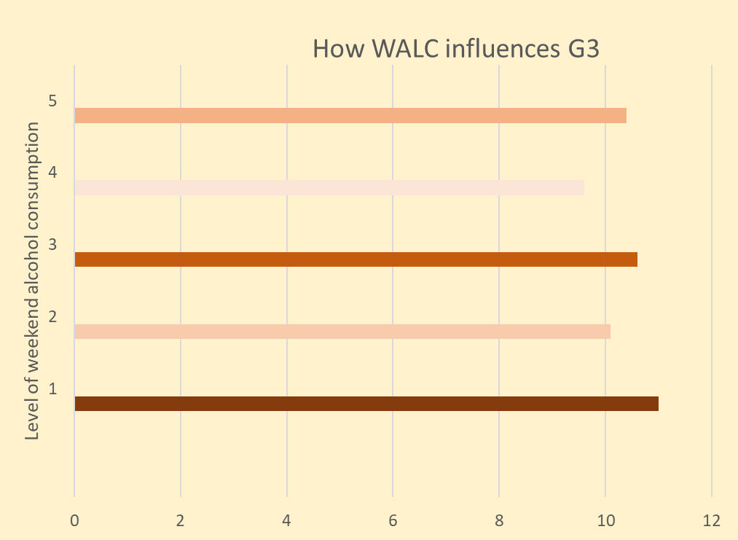
Factors considered
While a lot of factors were considered that potentially has an influence on the final grade ‘G3’ , some of the factors that clearly had an impact were: •Weekend alcohol consumption (WALC)•Going out with friends (GOOUT)•Weekly studytime (Studytime)•Willing to pursue higher education (Higher)•Number of past class failures (Failures)
A graph representing one of the factors for predicting G3 is given here: These plots make it very evident that alcohol use has an average negative impact on grades (G3). Higher alcohol consumption in particular is linked to poorer academic performance.

Slide 5
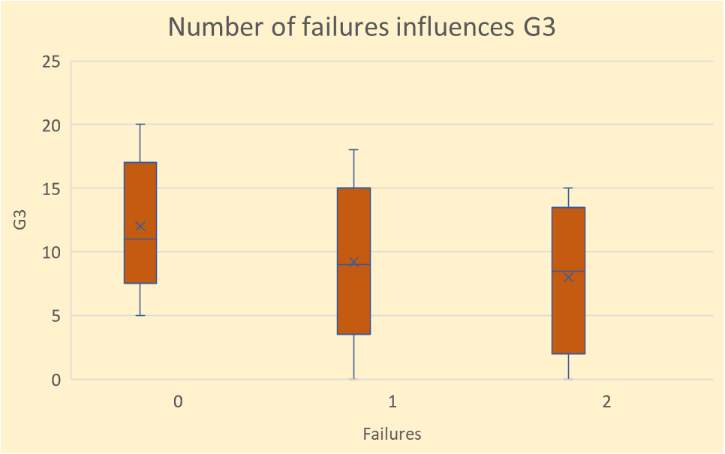
The primary influencing factor
Looking at the aforementioned factors, we can observe that G3 is most impacted by the number of past failures. As there are more failures, the median value of G3 decreases. As a result, their relationship is inversely proportionate

Slide 6

Conclusions
Hence, we conclude that according to the given EDA, "Studytime," “Higher," “Failures," “GOOUT," and "WALC" are the five most crucial factors for the prediction of G3.
Additionally, the "failures" variable is by far the most crucial to predict the desired output G3 of a student.

Slide 7

Thank you!

